Slide 1
TASK 2:
Predicting customer buying behavioUr

Slide 2
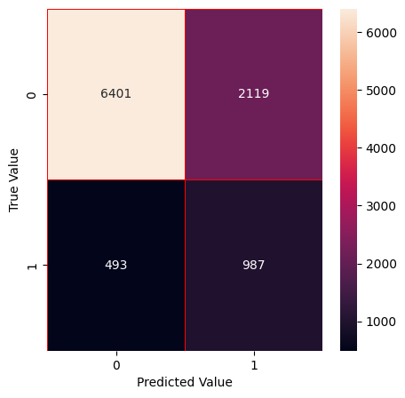
Accuracy of the model : 85.62%

